Slide 1
Complex Facial Emotion Classification
CS 554 - Computer Vision Project.
Aydamir Mirzayev, Irmak Türköz

Slide 2
I. A Introduction
Major components of nonverbal messages : Facial Expression
State-of-the-art : 87% accuracy for only 6 basic emotions[1].
recognition accuracy is very low for anger and sadness, worst for fear and disgust [2].
Can there be a problem with the number of classes?
More classes might be more discriminatory.
[1] J. Bassili, “Emotion recognition: The role of facial movement and the relative importance of upper and lower areas of the face,” J. Pers. Soc. Psychol., vol. 37, pp. 2049–2058, 1979.
[2] S. Zhalehpour, O.Onder, Z.Akhtar and C.E.Erdem, “BAUM-1: ASpontaneous Audio-Visual Face Database of Affective and MentalStates”, IEEE Trans. on Affective Computing, , Database web site:http://baum1.bahcesehir.edu.tr DOI: 10.1109/TAFFC.2016.2553038
Notes:
Irmak
Compare to other areas with neural networks high state-of-the-art over than 95 percent, the facial expression has much lower state-of-the-art
Major components of non-verbal messages are facial expressions, body/head gestures and the paralinguistic properties of speech.
application areas of emotion recognition : multi-modal human computer interaction, security (lie-detection etc),education, health-care, marketing and advertising.
Trained observers are reported to achieve an average facial expression recognition accuracy rate of 87 percent

Slide 3
I.B Problem Definition
6 basic emotions:
Happiness, Anger, Sadness, Disgust, Fear, Surprise
13 Emotions (More complex):
Happiness, Anger, Sadness, Disgust, Fear, Surprise, Boredom, Contempt, Unsure, Interest, Neutral, Thinking, Concentrating, Bothered
Audio - Visual Data :
Use the audio information together with visual information.
Notes:
Irmak
In this project we aim to address multimodal emotion classification with audio and audio visual data
Instead of existing models that works with 7 basic emotions, we assess 13 emotions which involves more complex emotions.

Slide 4
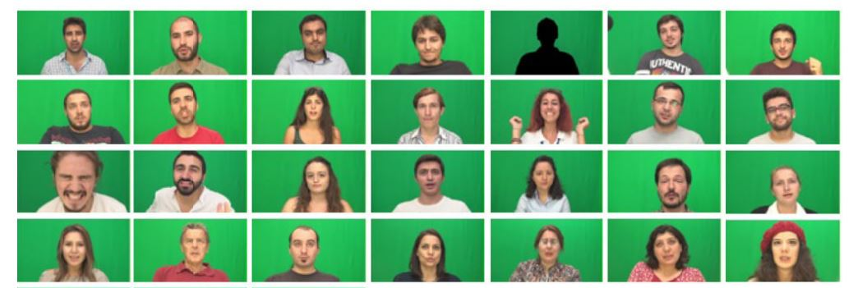
I.C Dataset
BAUM -1 Dataset is used.
[2] S. Zhalehpour, O.Onder, Z.Akhtar and C.E.Erdem, “BAUM-1: ASpontaneous Audio-Visual Face Database of Affective and MentalStates”, IEEE Trans. on Affective Computing, , Database web site:http://baum1.bahcesehir.edu.tr DOI: 10.1109/TAFFC.2016.2553038
Notes:
Irmak:
Most databases available today are acted or do not contain audio data.
BAUM -1
BAUM -1 includes clips obtained by recording the subjects from the frontal view using a stereo camera and from the half-profile view using a mono camera.

Slide 5
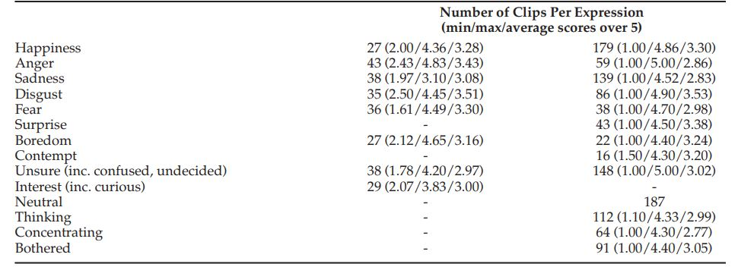
I.C Dataset
BAUM -1 Dataset:
Spontaneous
Audio data available
13 Emotions
31 Subjects.
1,184 Clips
[2] S. Zhalehpour, O.Onder, Z.Akhtar and C.E.Erdem, “BAUM-1: ASpontaneous Audio-Visual Face Database of Affective and MentalStates”, IEEE Trans. on Affective Computing, , Database web site:http://baum1.bahcesehir.edu.tr DOI: 10.1109/TAFFC.2016.2553038
Notes:
Irmak:
Most databases available today are acted or do not contain audio data.
BAUM -1
BAUM -1 includes clips obtained by recording the subjects from the frontal view using a stereo camera and from the half-profile view using a mono camera. Subjects are shown different videos and their spontaneous reactions were recorded.

Slide 6
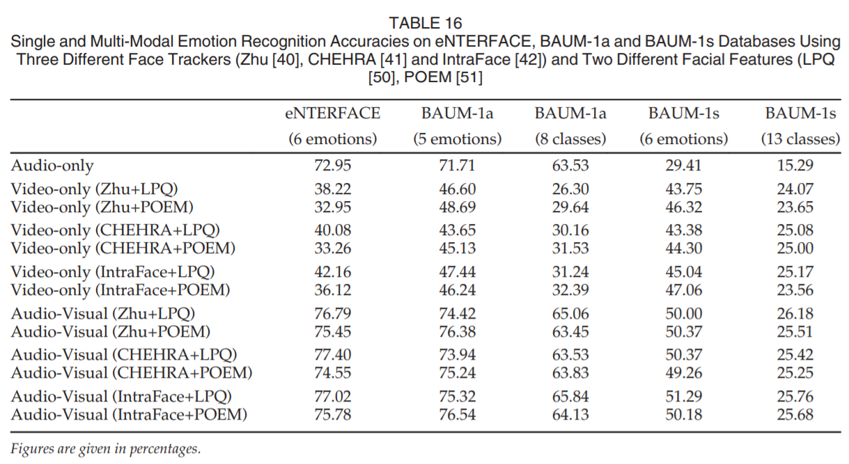
I.C Dataset: State-of-the-art
[2] S. Zhalehpour, O.Onder, Z.Akhtar and C.E.Erdem, “BAUM-1: ASpontaneous Audio-Visual Face Database of Affective and MentalStates”, IEEE Trans. on Affective Computing, , Database web site:http://baum1.bahcesehir.edu.tr DOI: 10.1109/TAFFC.2016.2553038

Slide 7
II.B Feature Extraction
Video: OpenFace Landmarks [3]
68 Face landmarks
12 eye region
10 eyebrow region
9 nose region
20 mouth region
17 contours
Normalized with respect to tip of the nose at the first frame as the origin and [-1,1] range
Illumination Normalization
Extractor for each frame.
Audio: MFCC [4]
Downsampled to from 44KHz to 11Khz
Mel spectral coefficients are extracted
Sequence Length: Windowing
Separate both audio and video into segments of 0.5s length
No overlapping is utilized
Residue is trimmed or padded
[3] B. Amos, B. Ludwiczuk, M. Satyanarayanan, ”Openface: A general-purpose face recognition library with mobile applications,” CMU-CS-16-118, CMU School of Computer Science, Tech. Rep., 2016.
[4] Hasan, Md Rashidul, Mustafa Jamil, and M. G. R. M. S. Rahman. "Speaker identification using mel frequency cepstral coefficients." variations 1.4 2006.
Notes:
Aydamir

Slide 8
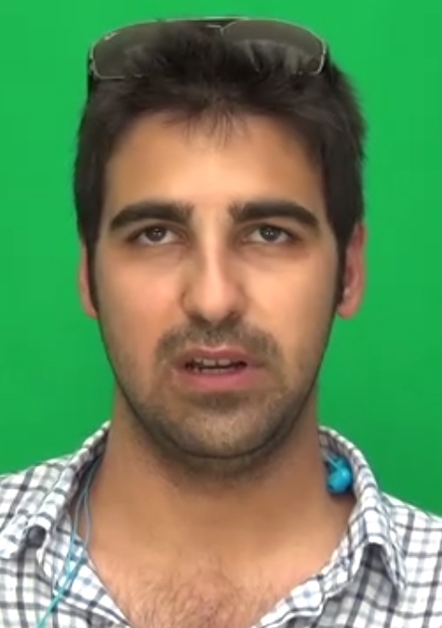
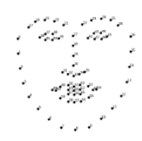
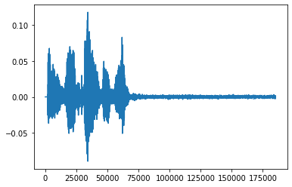
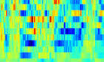
II.B Feature Extraction
0.5 second windows
X1[t]
X2[f]
Video
Landmark sequence
Audio
MFCC

Slide 9
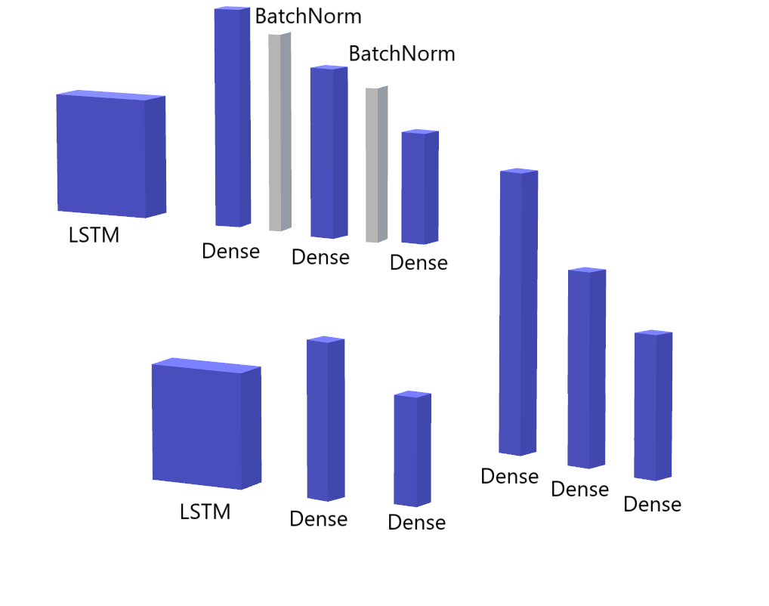
II.C Optimal Model
Upper Brach
Landmark sequences are fed to the upper network
3 Additional Dense Layers with Batch normalization
Leaky ReLU activation.
Lower Brach
Sound sequences are fed to the lower network
2 Additional Dense Layers
Leaky ReLU activation.
Late Fusion
3 Dense Layers
Leaky ReLU activation.

Slide 10
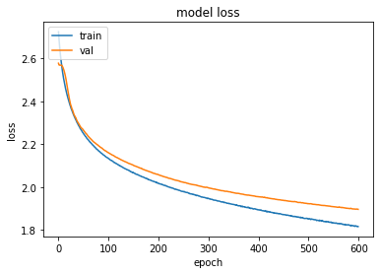
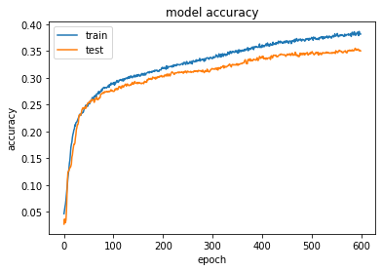
II.C.a Optimal Model: Results
Adagrad Optimizer, Batch Size: 128
LR 10⁻⁴
Final Accuracy: 0.35 with 13 classes
Notes:
Aydamir

Slide 11
II.C.b Other Models
We have also experimented with many other models with visual features:
-Xception Parameters = 22,910,480 Depth = 126 Loss : 2.2860 Accuracy : 0.1523
-VGG16 Parameters = 138,357,544 Depth = 23 Loss : 2.4788 Accuracy: 0.1719
-MLP Parameters = 65,325 Depth = 9 Loss: 3.0862 Accuracy: 0.1875
Notes:
Irmak
Because we want to compare the audio - visual feature with only visual features, we have experimented with some other models on visual features extracted from openface.
Xception : The main reason : have the best state-of-the-art results regarding to face recognition problems. We have realized xception is too deep for our case because we already give the features.
VGG 16 : VGG16 is shallow network with less layers, however it is proven to be good for image analysis. Did not worked, probably because it works better with regions instead of facial landmarks.
We also tried Multi Layer Perceptron which is one of the most basic neural network with a few batch normalization and dense and dropout layers. However accuracy was still too low.
Problem with visual features : only 100 x 136 features for each datapoint. Lose too much information.

Slide 12
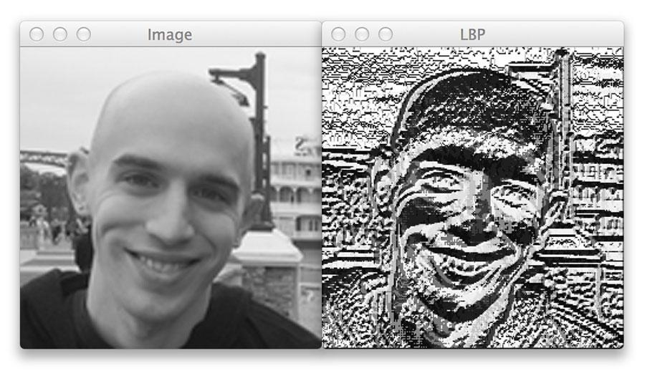
III. In Progress : Local Binary Patterns
The facial landmarks → not informative.
LBP is promising, even with shallow network: Multi-Layer-Perceptron[2].
The MLP neural network consists of 4 layers - an input layer, 2 hidden layers and an output layer
[5] Rosebrock, “A. Local Binary Patterns with Python & OpenCV”. pyimagesearch.com. December 7, 2015. Online. Available : https://www.pyimagesearch.com/2015/12/07/local-binary-patterns-with-python-opencv/ [Accessed: 20-04-2020]
[6]Khan, Fuzail. (2018). Facial Expression Recognition using Facial Landmark Detection and Feature Extraction on Neural Networks.
Notes:
According to Khan et al. extracted facial features that are type of histogram can work well with Multi - Layer - Percaptron. We already implemented a MLP in the previous stage, we will only change the visual landmarks to LBP
because most likely our best model learns from audio data and visual data is not informative as we have seen with only visual trained networks.

Slide 13
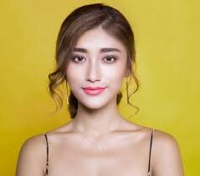
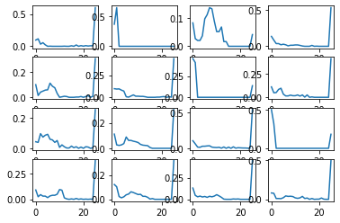
III. In Progress : Local Binary Patterns
Divide bounding box of face into 4x4 grid. Extract LBP from each of the areas.
1184 Videos, 500 Frames each, 16x24 LBP feature for each frame.
Notes:
Irmak
We now implemented another feature extraction algorithm.
LBP are proved to work well with the facial analysis.
However, as there are over a thousand video clips and there are average number of five thousand frames, It takes too long.
Currently, the system is still extracting the LBP features into a csv file.

Slide 14
IV. Future Work (Final Report)
Instead of using feature landmarks → replace with LBP
and train the audio-visual feature model with it.
train seperate model with only visual feature(LBP)
Compare the audio-visual model with visual model
Evaluate if the audio is informative
Compare to state-of-the-art.
Notes:
Irmak & Aydamir

Slide 15
References
[1] J. Bassili, “Emotion recognition: The role of facial movement and the relative importance of upper and lower areas of the face,” J. Pers. Soc. Psychol., vol. 37, pp. 2049–2058, 1979.
[2] S. Zhalehpour, O.Onder, Z.Akhtar and C.E.Erdem, “BAUM-1: ASpontaneous Audio-Visual Face Database of Affective and MentalStates”, IEEE Trans. on Affective Computing, , Database web site:http://baum1.bahcesehir.edu.tr DOI: 10.1109/TAFFC.2016.2553038
[3] B. Amos, B. Ludwiczuk, M. Satyanarayanan, ”Openface: A general-purpose face recognition library with mobile applications,” CMU-CS-16-118, CMU School of Computer Science, Tech. Rep., 2016.
[4] Hasan, Md Rashidul, Mustafa Jamil, and M. G. R. M. S. Rahman. "Speaker identification using mel frequency cepstral coefficients." variations 1.4 2006.
[5] Rosebrock, “A. Local Binary Patterns with Python & OpenCV”. pyimagesearch.com. December 7, 2015. Online. Available : https://www.pyimagesearch.com/2015/12/07/local-binary-patterns-with-python-opencv/ [Accessed: 20-04-2020]
[6]Khan, Fuzail. (2018). Facial Expression Recognition using Facial Landmark Detection and Feature Extraction on Neural Networks.

